Slide 1
INTRODUCTION TO COMPUTING
Course Code: CCINCOM/L
Solving for Recurrences
Department of Computer Science
College of Computing and Information Technologies (CCIT)
National University
Joseph Marvin R. Imperial
ALGORITHMS AND COMPLEXITY
NU College of Computing and Information Technologies
Course Code: ALGOCOM

Slide 2
Time Complexity
the computational complexity that describes the amount of time it takes to run an algorithm (through various data)
an algorithm's running time may vary among different inputs of the same size.
time complexity is generally expressed as a function of the size of the input.
commonly estimated by counting the number of elementary operations performed by the algorithm
ALGORITHMS AND COMPLEXITY
Course Code: ALGOCOM

Slide 3
Time Complexity
one commonly focuses on the behavior of the complexity (through graphs) when the input size increases—that is, the asymptotic behavior of the complexity.
ALGORITHMS AND COMPLEXITY
Course Code: ALGOCOM

Slide 4
Recursion
A phenomenon that occurs when a thing is defined in terms of itself or of its type.
Methods exhibit recursive behavior when they can be defined by two properties:
A simple base case (or cases)—a terminating scenario that does not use recursion to produce an answer
A set of rules that reduce all other cases toward the base case
ALGORITHMS AND COMPLEXITY
Course Code: ALGOCOM

Slide 5


Example Recursion (Fibonacci Sequence)
1 1 2 3 5 8 13
The Fibonacci sequence is a classic example of recursion:
ALGORITHMS AND COMPLEXITY
Course Code: ALGOCOM

Slide 6
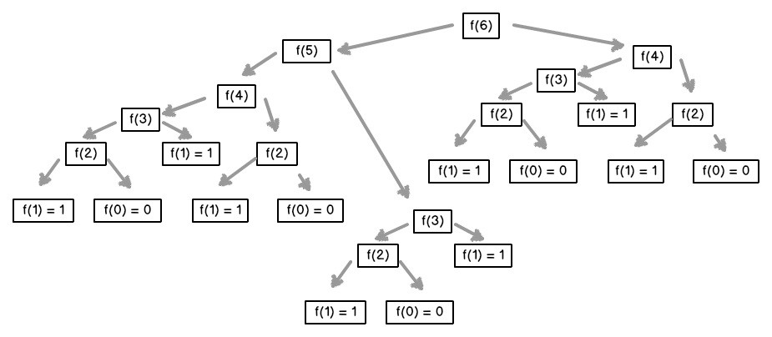
Example Recursion (Fibonacci Sequence)
ALGORITHMS AND COMPLEXITY
Course Code: ALGOCOM

Slide 7
Activity
Try implementing it an iterative and recursive Fibonacci sequence in Python.
ALGORITHMS AND COMPLEXITY
Course Code: ALGOCOM

Slide 8
Recurrence Relations
A recurrence relation is an equation which is defined in terms of itself.
Many algorithms particularly divide and conquer algorithms have time complexities which are naturally modeled by recurrence relations.
Solving for recurrences or the closed form of recurrences can give the time complexity of divide and conquer algorithms.
Denoted as T(n)
ALGORITHMS AND COMPLEXITY
Course Code: ALGOCOM

Slide 9
How to solve recurrence relations iteratively
Establish recurrence conditions.
Iteratively “unfold” the recurrence until you “see the pattern”.
Get the closed form of the recurrence in terms of n.
Identify the complexity (in terms of Big O) of the closed form.
ALGORITHMS AND COMPLEXITY
Course Code: ALGOCOM

Slide 10
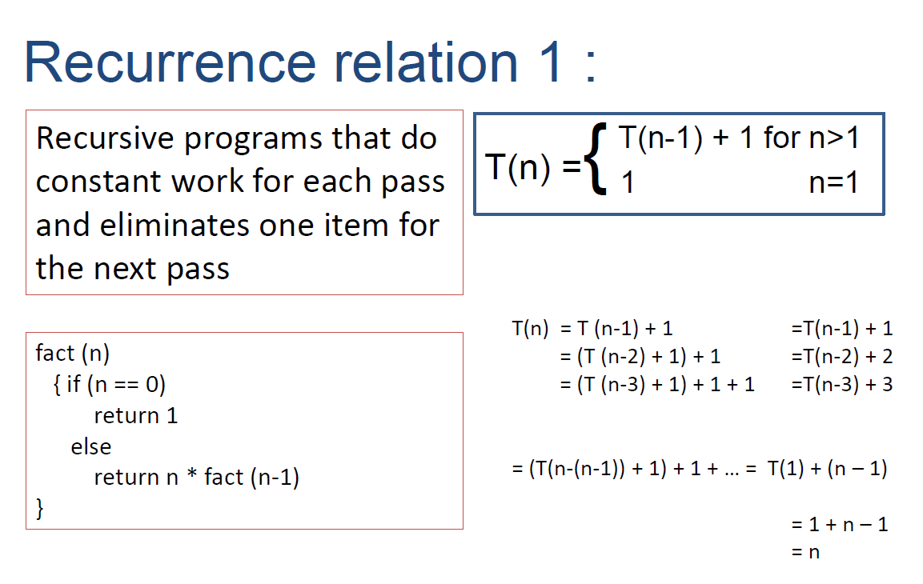
ALGORITHMS AND COMPLEXITY
Course Code: ALGOCOM

Slide 11
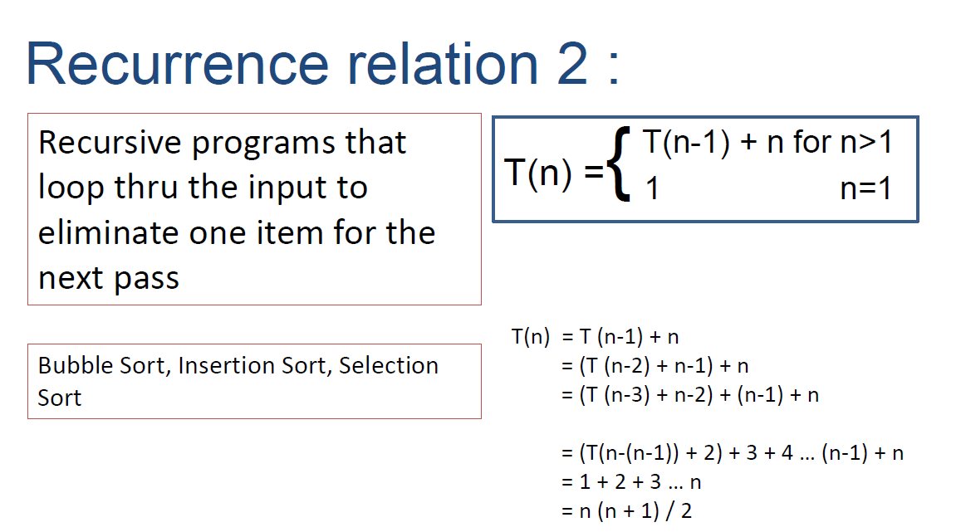
ALGORITHMS AND COMPLEXITY
Course Code: ALGOCOM

Slide 12
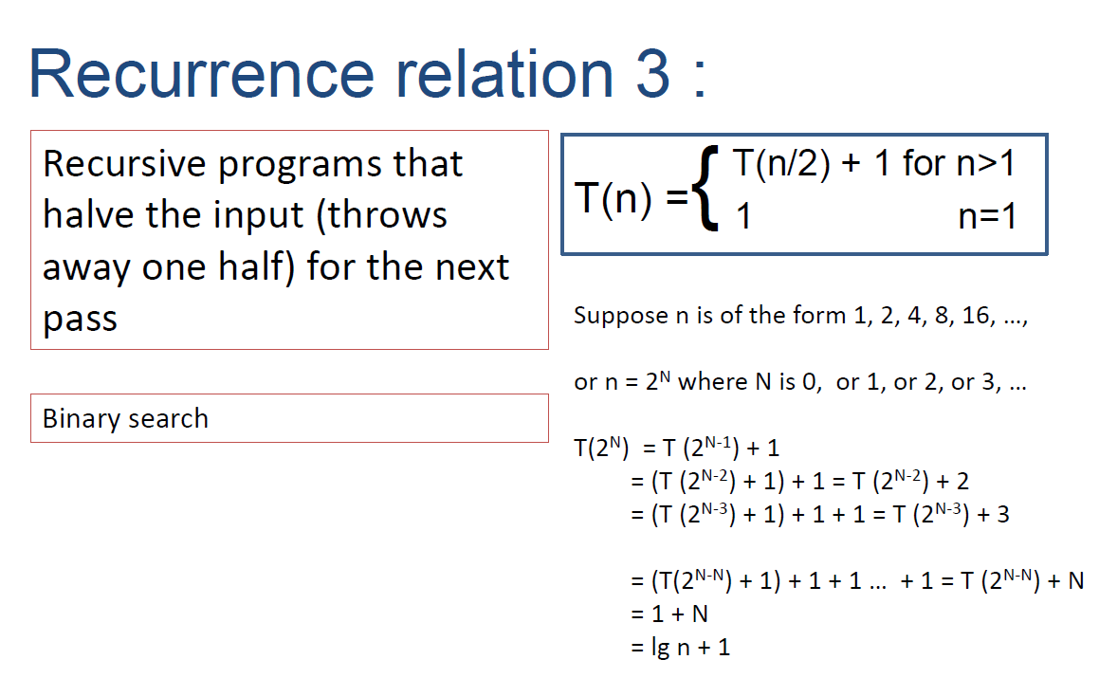
ALGORITHMS AND COMPLEXITY
Course Code: ALGOCOM

